Slide 1
Keep Your Distance! Real-time Social Distancing Using Wearable ESP32s
Ryan Williamson – 2306841w
Notes:
9 out of 10 seconds
Hi I’m Ryan Williamson and my project is Real-time Social Distancing Using Wearable ESP32s. During this presentation I will give a brief overview of each area of my dissertation.

Slide 2
Background
Notes:
3 out of 60 seconds total, including next two slides
I will briefly discuss my key areas of background research

Slide 3
Contact Tracing
N. Ahmed, R. A. Michelin, W. Xue, S. Ruj, R. Malaney, S. S. Kanhere, A. Seneviratne, W. Hu,
H. Janicke, and S. K. Jha. A Survey of COVID-19 Contact Tracing Apps. IEEE Access, 8:
134577–134601, 2020. ISSN 2169-3536. doi: 10.1109/ACCESS.2020.3010226. Conference
Name: IEEE Access.
Notes:
40 out of 30 seconds
Given the effects, and mode of transmission of COVID-19, various governments created social distancing guidelines; from this rose digital contact tracing using these guidelines to estimate chances of infection.
To estimate distance, contact tracing technologies have, for the most part, settled on Bluetooth Low Energy (known as BLE).
Contact tracing apps follow three architectural styles: Centralised, Decentralised, and Hybrid.
Centralised makes use of a main server to store data and handle operations, this is a privacy risk as the main server stores all information.
Decentralised does as much of the data processing as possible on the mobile device, this has better privacy but poorer exposure identification.
Hybrid is a combination of both, the architecture of which can be seen here, so balances the pros and cons of these approaches.

Slide 4
Bluetooth Low Energy (BLE)
J. Yang, C. Poellabauer, P. Mitra, and C. Neubecker. Beyond Beaconing: Emerging Applications
and Challenges of BLE. Ad Hoc Networks, 2020. doi: 10.1016/j.adhoc.2019.102015.
Notes:
25 out of 30 seconds
For this project BLE was used for proximity estimation for the low power draw; Classic Bluetooth can draw 100% more power than BLE.
While BLE may have similarities to classic Bluetooth, it has a different technology stack, the centre column of this image shows how devices support both technologies.
Distance can be estimated by using the Received Signal Strength Indication. This is a measure of the reliability between BLE devices, typically as distance increases RSSI lowers.

Slide 5
Analysis & Requirements
Notes:
3 out of 60 seconds total including next two slides
Now I will discuss the requirements gathering and analysis process

Slide 6
Functional Requirements
(M) Real-time RSSI Proximity Sensing
(M) Log data to linked device for visualisation
(M) Visualisations on app
(S) Configurable device
(S) Precision in RSSI Proximity Sensing
(C) Live visualisation updates on new RSSI value
(C) Adaptive Advertising Intervals
(C) Organisation owned devices
(C) Battery indication on request
Non-functional Requirements
(M) Colour-blind Accessibility
(M) Responsiveness
(M) Ease of Use
(M) App Design
(S) Subtle Alert
(C) Organisational Privacy
Requirements Gathering
Notes:
17 out of 30 seconds
Requirements were gathered in stages.
First a mind map was created to identify key ideas and themes.
The user personas, stories, and scenarios were created to take the core ideas and provide a structured, user motivated, view of core concepts.
Finally, Functional and Non-functional requirements were identified and prioritised using the MoSCoW method, as seen here.

Slide 7
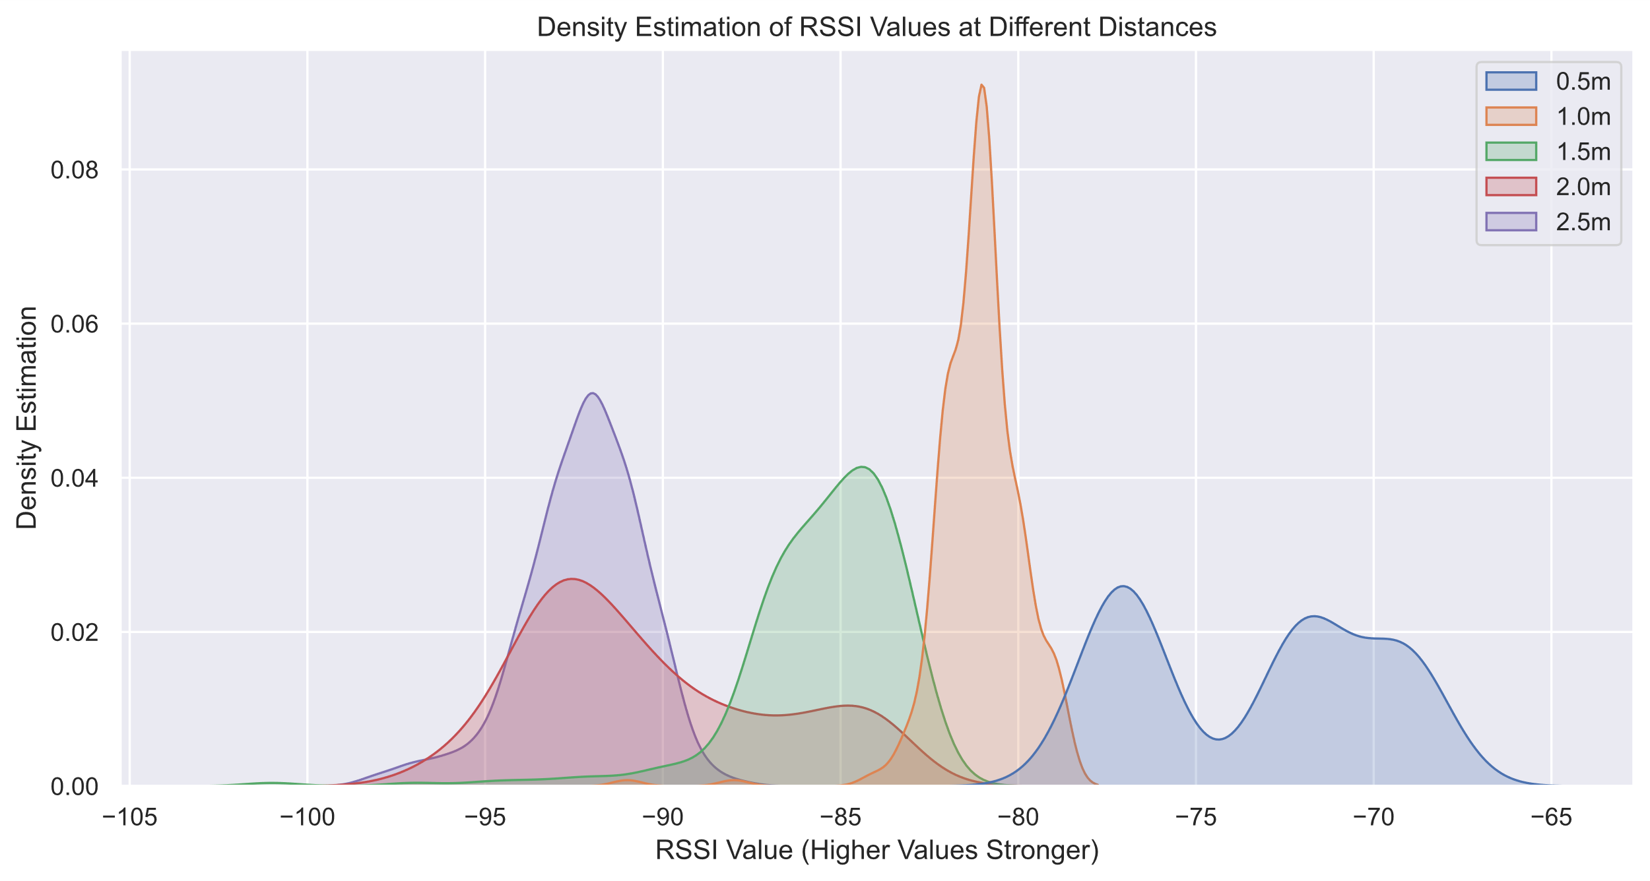
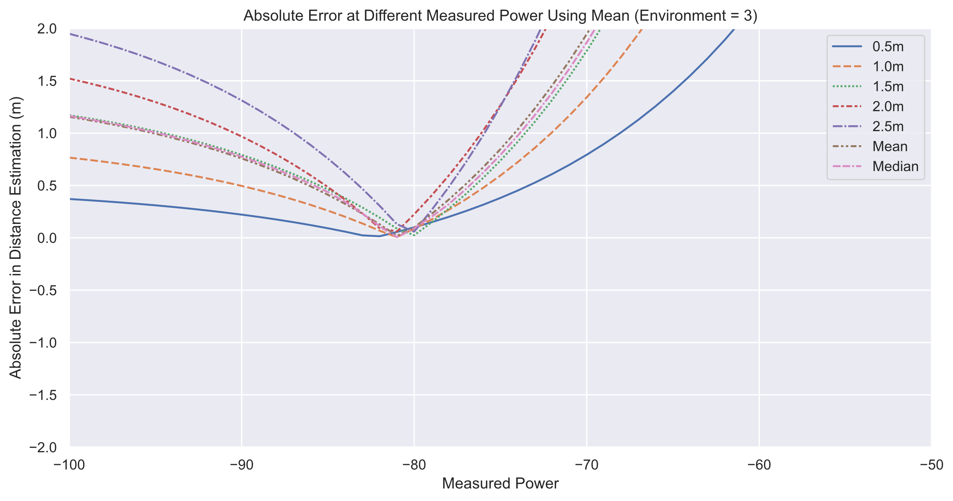
Exploratory Data Analysis
Notes:
27 out of 30 seconds
Exploratory data analysis was conducted twice. Early in the prototype to prove project viability, and late in the project to fine-tune parameters and for requirement validation.
The aim was to identify values for two parameters required by the distance estimation formula – the measured power, and environmental factor.
By obtaining 1 RSSI value per second, for 250 seconds at 5 distances ranging from 0.5 metres to 2.5 metres, then graphing as seen above to determine density estimates and best fit values, the best parameter values were identified.

Slide 8
Design & Implementation
Notes:
3 seconds of 6 minutes total across next 9 slides
I will now briefly describe the design and implementation process

Slide 9



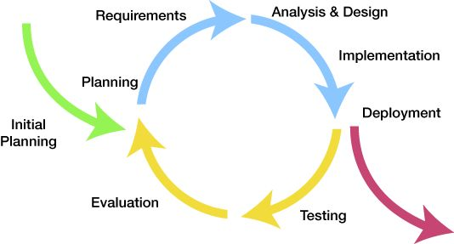
Software Engineering Process
https://curtisbacon.wordpress.com/2014/10/12/design-iteration/
Notes:
21 out of 30 seconds
The project followed an iterative software development process, with the work being split into weekly sprints. This allowed for early prototypes to be tested for viability.
For version control Git was used, with the repository being hosted on GitHub. The GitHub wiki feature was also used to contain meeting minutes, and project notes.
Finally for Issue tracking Notion, an integrated note taking and task manager, was used. This allowed for easy integration into my existing workflow.

Slide 10
Chosen Technologies
Notes:
22 out of 30 seconds
This is the system architecture diagram for the project. It shows the use of an ESP32 device and Android device which was the hardware chosen for this project.
For ESP32 development Platform IO was used as the development and deployment tool, it had mature integration with the ESP32 and the Arduino framework used for development.
For Android app development Java was chosen over Kotlin; Even though Kotlin is now the recommended language, Java is more familiar to me and has more documentation.

Slide 11
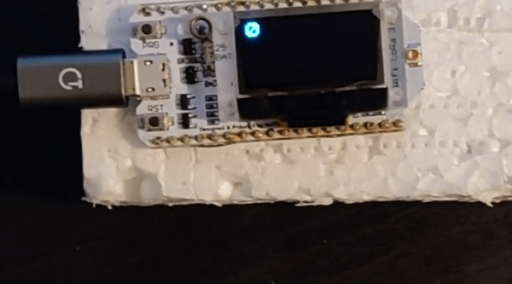
ESP32: Detection & Notification
Notes:
35 out of 45 seconds
Shown here is an ESP32 device notifying the user that it is too close to another ESP32 device.
The notification system was built to be extendable, using an abstraction layer between the notification system and the concrete implementations. This was used in the project to add support for using vibrotactile motors for haptic feedback.
Device detection is performed via connection-less BLE communication. This works by having each device advertising its presence and scanning for other devices in parallel. A limitation here is the scan interval of an ESP32 has a minimum duration of 1 second, so there can be a large latency between devices entering each others space and a notification.

Slide 12
$$RSSI\left(dBm\right)={RSSI}_{\left(1m\right)}\left(dBm\right)−10n\log_{10}\left(d\right),$$
ESP32: Proximity Estimation
Notes:
48 out of 45 seconds
Proximity estimation, used to determine closeness of detected devices, was performed using a free-space path loss model equation, as shown above. Specifically this formula calculated a target RSSI value for a given distance d, when the RSSI signal is stronger than this threshold the devices are considered close enough to be a potential social distancing breach.
Since RSSI values within Bluetooth Low Energy are volatile an averaging system was required to smooth out the values are provide a more consistent user experience. For the averaging operation an exponential moving average was used for its better space complexity.
To keep track of the averaged value for each device connection a red-black tree was implemented. Above is the node diagram for a tree node, the mac address is what the tree is indexed on. The timestamp here is used as a timeout value, if it’s been more than 5 seconds since the previous averaging operation on that device then it will reset instead of average again.

Slide 13
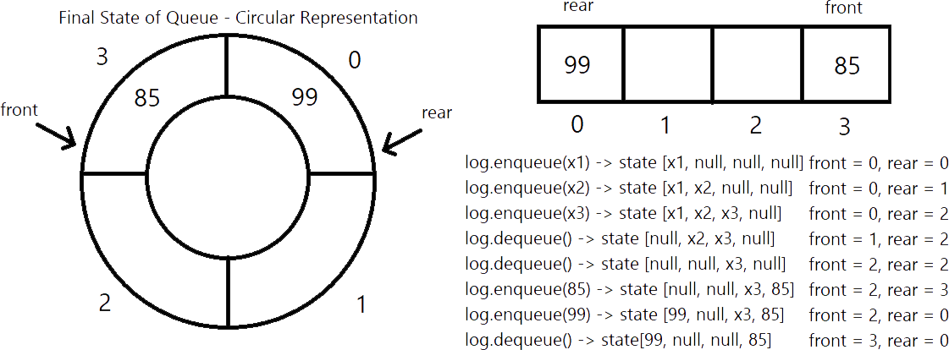
ESP32: Interaction Transmission & Storage
Notes:
26 of 45 seconds
When an interaction occurs between ESP32 devices one of two things will occur.
If the ESP32 device is currently connected to the Android phone then it will immediately transfer the interaction data. If not connected then the RSSI value will be stored for later transmission.
Since the device only has volatile storage this data is stored in RAM. To do this a circular queue was used as the data should be sent in the order it was collected, and by using a circular queue instead of a standard queue the storage space could be better used.

Slide 14
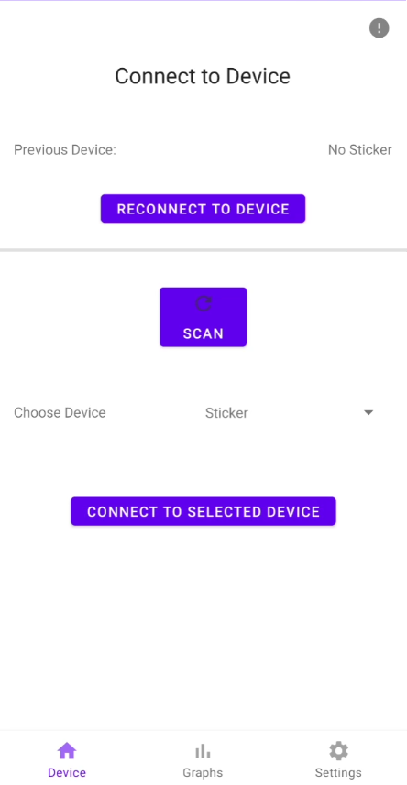
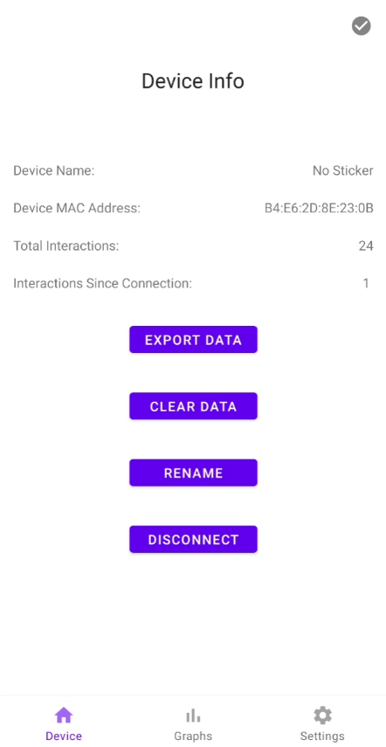
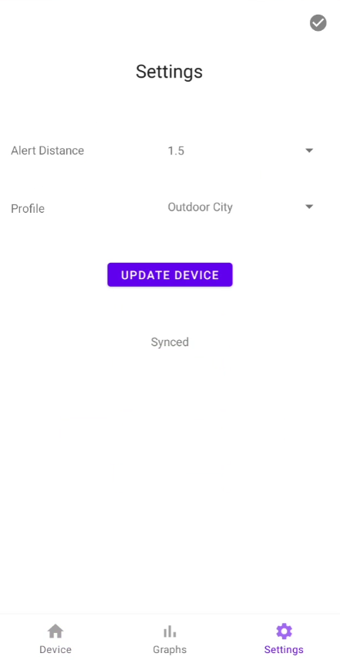
App: Overall UI
Notes:
28 out of 30 seconds
Shown here is the UI for three of the app screens, from left to right: The connect page, the information page, and the settings page.
UI was designed to respond to two states: connected and disconnected. When connected certain functionality changes, for example the update device button and synced status on the settings page only appears when connected.
UI was implemented using a base activity and a fragment container to change between the pages. For data interactions a view model was used, as Android has support for a model view controller architecture.

Slide 15
App: Visualisations
Notes:
32 of 30 seconds
There were three visualisation pages designed. A weekly interactions bar chart giving the amount of interactions per day for the last 7 days. Two pie charts, for giving a categorised view of average duration and distance of interactions. A trend line graph showing the user how their interaction amount was trending over all time, with a gradient on the line to show level of danger.
A key aspect of the data visualisation design was carefully selecting colour palettes for colour blindness. A colour blindness simulator was used and a palette was chosen that worked for all but two forms of colour blindness as shown above. On the left is tritanopia and on the right achromatopsia.

Slide 16
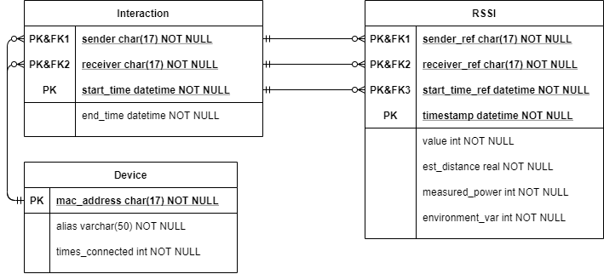
App: Database
Notes:
38 of 45 seconds
The database was a critical component of the app architecture. Shown here is the Entity Relationship diagram used to model the database. There are three entities: Device; used to model different ESP32 devices, Interaction; used to store information about an entire interaction, and RSSI; used to store information about a single part of an interaction.
For database implementation the Android Room persistence library was used. This is an abstraction on top of an SQLite database allowing for a reduction in boilerplate code and compile time query validation. To ensure that only one database was constructed at a time the Singleton design pattern was used.
Finally, custom export functionality was written to allow for exporting the database to a csv file for each table.

Slide 17
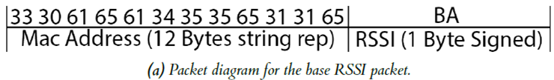
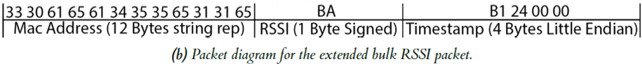
App: Receiving & Processing Interactions
Notes:
42 of 45 seconds
For receiving the interaction data being sent via Bluetooth Low Energy from the ESP32 I used the Blessed library for Android. This library provides higher level access to the BLE components, allowing for less connection management code to be written. The Bluetooth handler code was abstracted away from the UI except for events that only occurred on specific pages, such as the settings page.
When data is received through a characteristic update event the system converts the received byte stream to the proper forms of the data. A HashMap is used to allow for checking the times received, which allows for chunking the RSSI data into separate interactions based on time. This has two forms, the standard RSSI packet and the Bulk RSSI packet as seen above,
Byte buffers were used to ensure that endianness conversion was performed without error, as the ESP32 is little endian and Android is big endian.

Slide 18
Evaluation
Notes:
5 of 1 minute 15 seconds
In this section I will briefly discuss the three stages of evaluation used in this project

Slide 19
Testing
Notes:
9 of 15 seconds
Unit testing was performed on the ESP32 with 45 tests, and on Android, as pictured here, with 86 tests. The UI of the app was not tested.

Slide 20
Experiment & Survey
Notes:
27 of 30 seconds
For the experiment formal ethical approval was obtained as the experiment used non-standard hardware, the ESP32.
The aims of the experiment were to gain a realistic view on system performance and to understand the usability of the created system. Due to COVID-19 restrictions this experiment could only be performed once.
To supplement this a non-contact survey was created via Google Forms. This survey used videos of the device and app in use and then asked questions based on those videos. This survey met all points on the ethics checklist so no formal approval was required.

Slide 21
Analysis Techniques & Key Results
Notes:
25 of 30 seconds
Both quantitative and qualitative data was obtained. For analysing the qualitative data open, axial, and selective coding was used as pictured in the top image. For quantitative data graphs were created and analysed to find key results.
A few key results from analysis were: The devices report distance inaccurately, the usability of the app was found to be high, the data visualisations created from personal data would changes user behaviour.

Slide 22
Conclusion
Notes:
46 of 45 seconds
This project aimed to suggest social distancing improvements to users in real time, while also educating the users and informing change on their habits in the long term. There was also a focus on system usability, specifically for users with colour blindness.
Through evaluation and testing it was shown that all Must have requirements for the system were met, with room for improvement on addressing the should have and could have requirements.
Areas for further work could include: switching from BLE to Ultrawide Band, using alternative distance approximation models, making the app multi-platform, and improving accessibility and usability of the system.
Finally, during this project I have improved skills built through my 4 years in university such as: time management, problem solving, architecture design, and communicating complex technical concepts in a simple manner. One thing I’d change is using test driven development throughout the project, instead of testing everything at the end.

Slide 23
Thank You
Notes:
3 seconds
Thank you for your time listening to my presentation.

